Slide 1

The decade of clean energy
Trends, opportunities, and risks that will shape the 2020s
Mark Dyson, Principal, Rocky Mountain Institute
Minnesota Legislative Energy Commission
November 13th, 2020

Slide 2
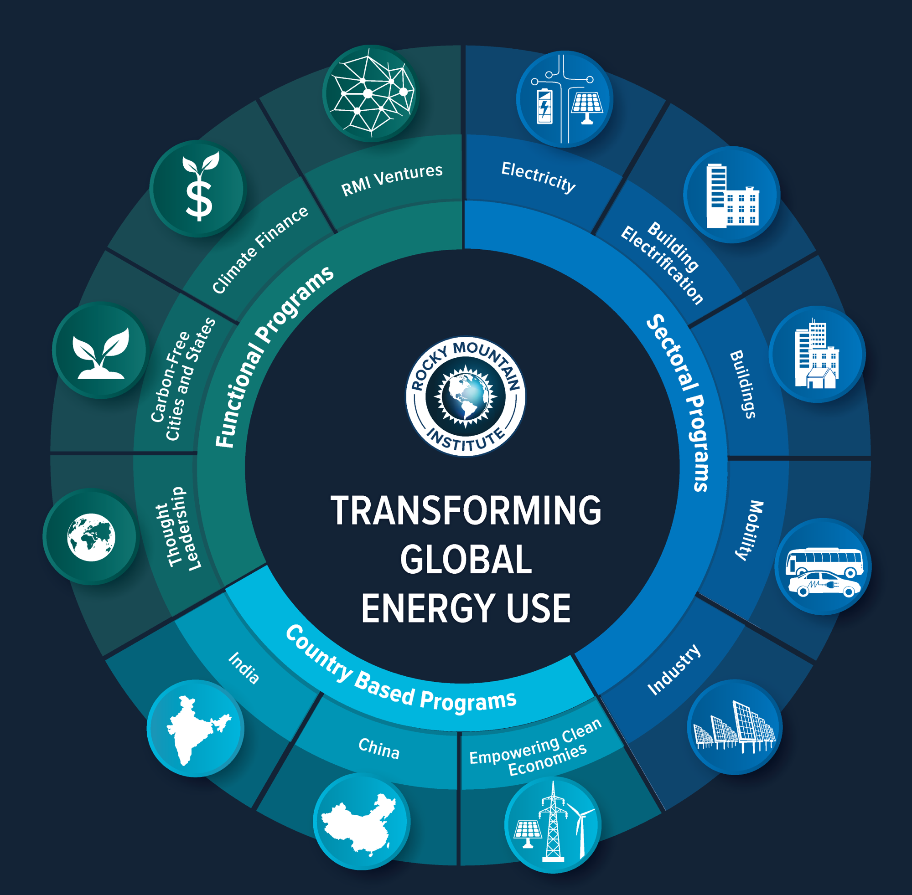
About
Rocky Mountain Institute
Nonprofit, nonpartisan, independent, research & collaboration firm
Founded 1982 in Colorado
Global scope
250+ staff (CO, NY, DC, CA, Beijing, Delhi)
Focus: Market-based approaches to clean energy

Slide 3
Three key messages
The 2020s will be the decade of clean energy
Clean energy technologies (wind, solar, and batteries) have fallen in price to the point where they beat all other forms of generation.
Combinations of clean energy resources can now cost-effectively provide all energy and reliability services provided by gas plants.
Cost declines create new opportunities for utilities and policymakers
Though “100% by 2050” targets are the de facto standard, questions remain about feasibility, costs, and near-term carbon reductions.
In the near term, today’s clean energy costs mean that achieving 90% carbon-free energy by 2035 is achievable, reliable, and cost-effective.
Ignoring clean energy trends creates stranded cost risks for consumers
Competitive market trends illustrate near-term business case for clean energy and stranded cost risk of new gas-fired power plants.
Policymakers and regulators of monopoly utilities can avoid stranded cost risk by requiring competitive, all-source procurement practices.

Slide 4
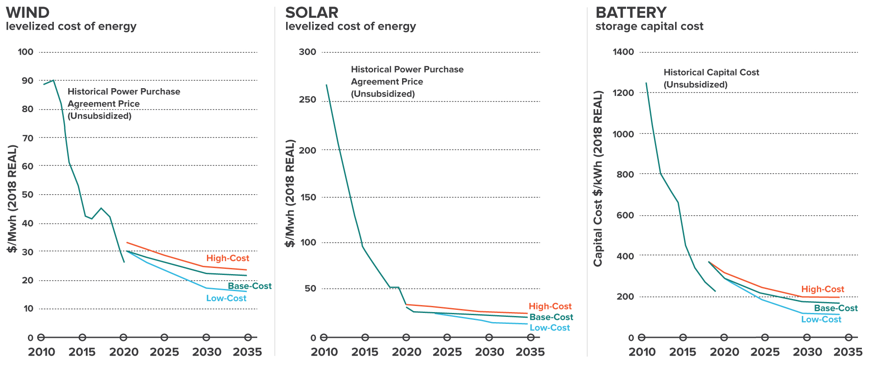
Driven by scale and innovation, the costs of wind, solar, and battery projects continue to fall, with no end in sight
Source: National Renewable Energy Lab as cited in the 2035 Report by UC Berkeley and GridLab: https://www.2035report.com/

Slide 5
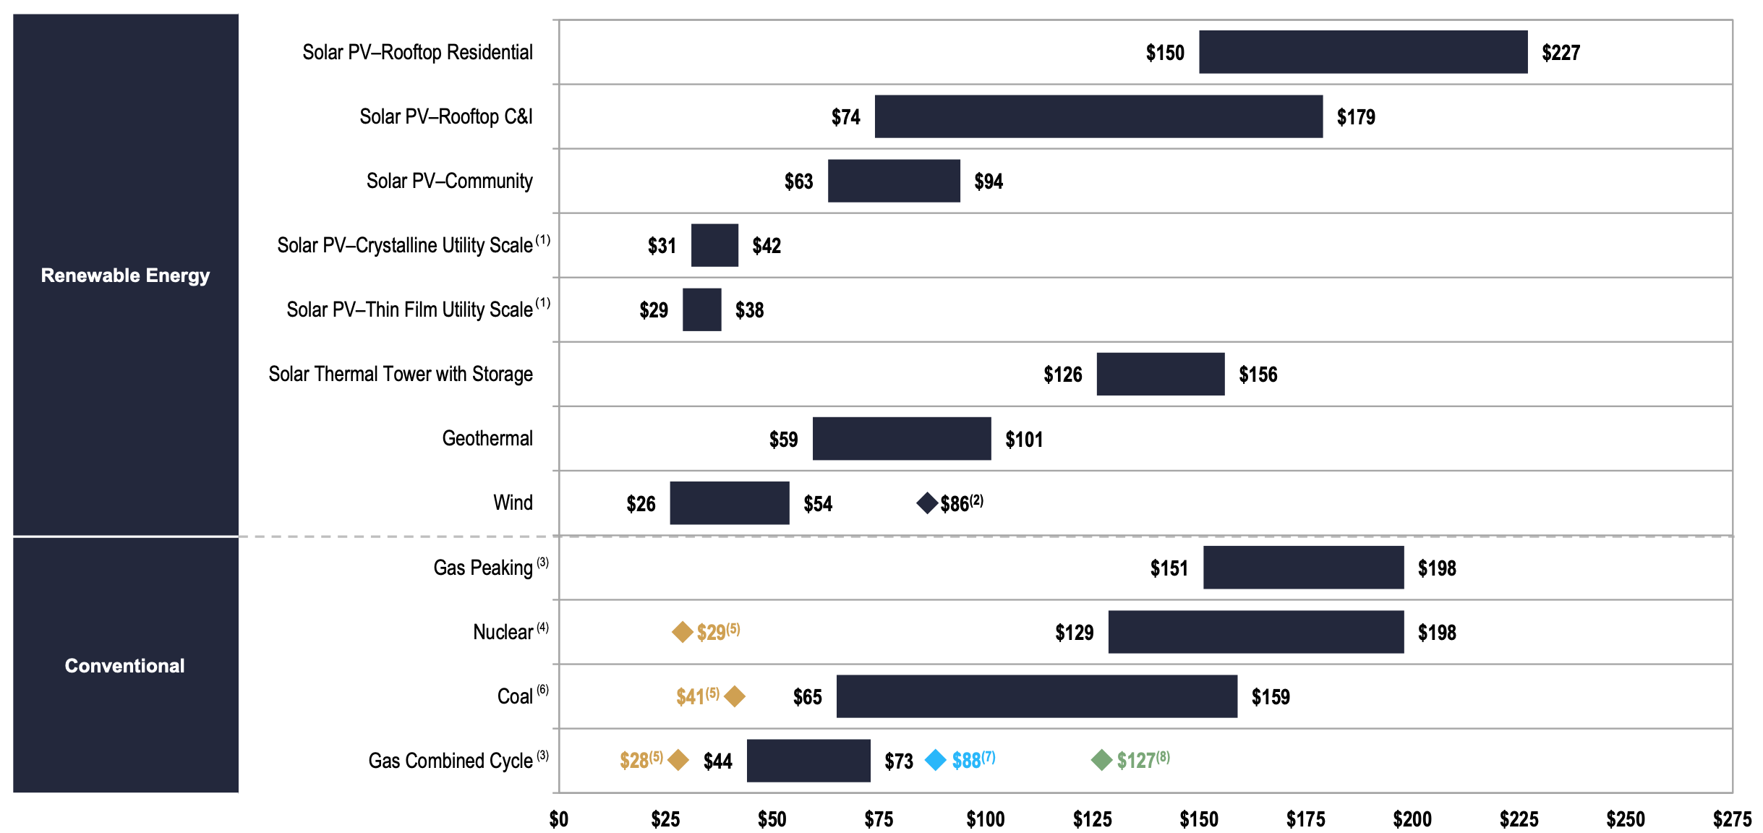
Unsubsidized renewables now undercut the costs of existing coal plants and new gas plants
Benchmark, unsubsidized levelized cost of energy – Lazard, 2020
Source: Lazard, Levelized Cost of Electricity 14.0;
https://www.lazard.com/perspective/levelized-cost-of-energy-and-levelized-cost-of-storage-2020/

Slide 6
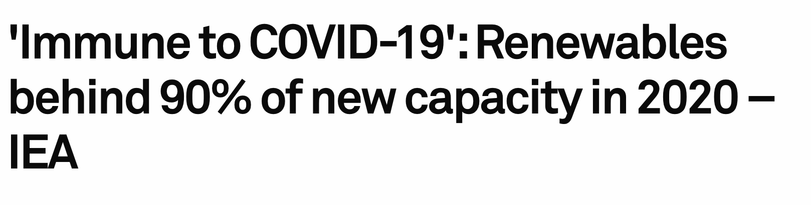



Globally, renewables are dominating new investment
“Renewable energy is set to defy the drag of the coronavirus pandemic and its economic shock and close the year with record installation figures and its highest ever share of newly built capacity”
“Investor appetite for renewables has been much stronger than for other energy sources”
Source: S&P Global, November 10, 2020: https://www.spglobal.com/marketintelligence/en/news-insights/latest-news-headlines/immune-to-covid-19-renewables-behind-90-of-new-capacity-in-2020-iea-61189791

Slide 7
Combinations of clean energy resources can now provide all grid services typically provided by fossil power plants
Annual energy
Peak capacity
Ramp/flexibility
Efficiency
Requirement
Demand
flexibility
Requirement
Demand
flexibility
Requirement
Efficiency
Efficiency
Storage
Wind
Storage
Wind
Solar PV
Solar PV
Solar PV
Source: RMI, The Economics of Clean Energy Portfolios; www.rmi.org/cep-reports

Slide 8
Three key messages
The 2020s will be the decade of clean energy
Clean energy technologies (wind, solar, and batteries) have fallen in price to the point where they beat all other forms of generation.
Combinations of clean energy resources can now cost-effectively provide all energy and reliability services provided by gas plants.
Cost declines create new opportunities for utilities and policymakers
Though “100% by 2050” targets are the de facto standard, questions remain about feasibility, costs, and near-term carbon reductions.
In the near term, today’s clean energy costs mean that achieving 90% carbon-free energy by 2035 is achievable, reliable, and cost-effective.
Ignoring clean energy trends creates stranded cost risks for consumers
Competitive market trends illustrate near-term business case for clean energy and stranded cost risk of new gas-fired power plants.
Policymakers and regulators of monopoly utilities can avoid stranded cost risk by requiring competitive, all-source procurement practices.

Slide 9
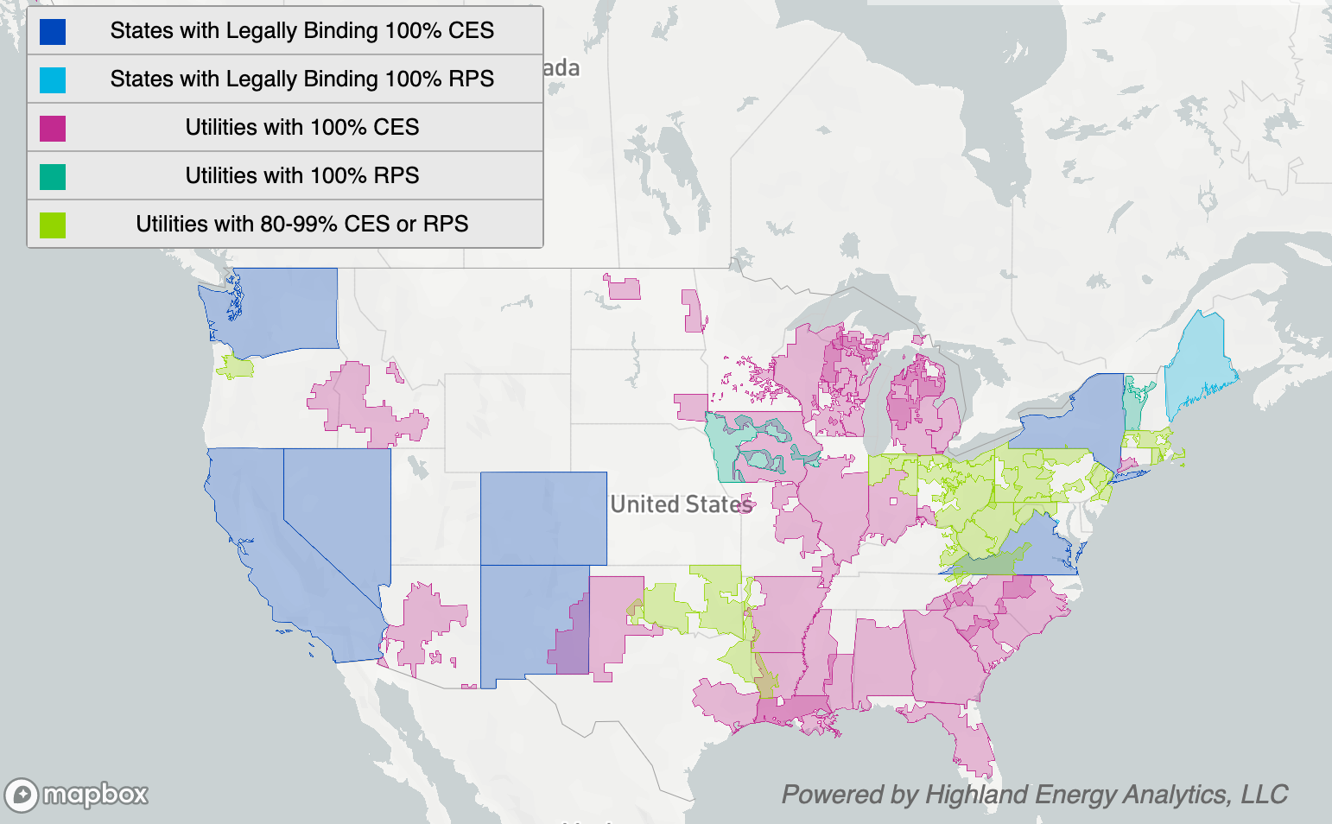
“100% by 2050” targets have emerged in recent years as the de facto standard for utility and state targets
“100%” targets and policies are gaining popularity, but questions remain around:
Technical feasibility and cost of the last 10-20% of carbon-free power
Intermediate targets and trajectory of emissions reductions
While 2050 targets are a useful North Star, market trends in 2020 highlight an additional opportunity to make ambitious near-term plans
Source: Clean Air Task Force; https://www.catf.us/2020/10/state-and-regional-decarbonization-commitments/

Slide 10
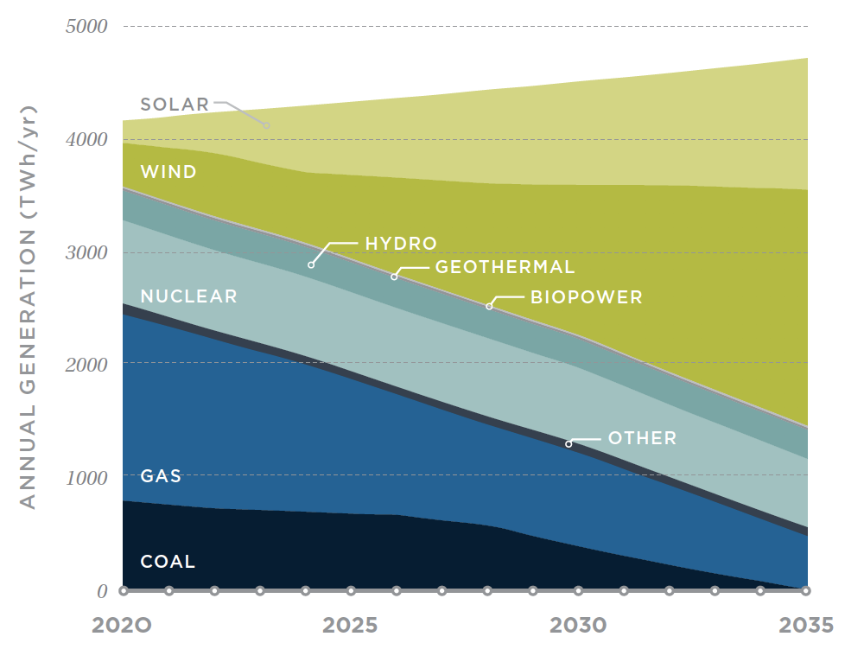
“90% by 2035” is the new “100% by 2050”:
Feasibility and reliability
Annual electricity generation | 90% carbon-free
Researchers have used production-grade grid modeling software across multiple years of weather data to illustrate the reliability and feasibility of a 90% clean electricity system by 2035, using only existing and commercially-available energy resources
New wind and solar, complemented by batteries, can economically replace higher-cost electricity from existing coal plants
Current hydro and nuclear capacity can continue to provide carbon-free generation
Retiring old, costly coal plants and running existing gas plants less will lower the costs for consumers
Source: 2035 Report by UC Berkeley and GridLab https://www.2035report.com/

Slide 11
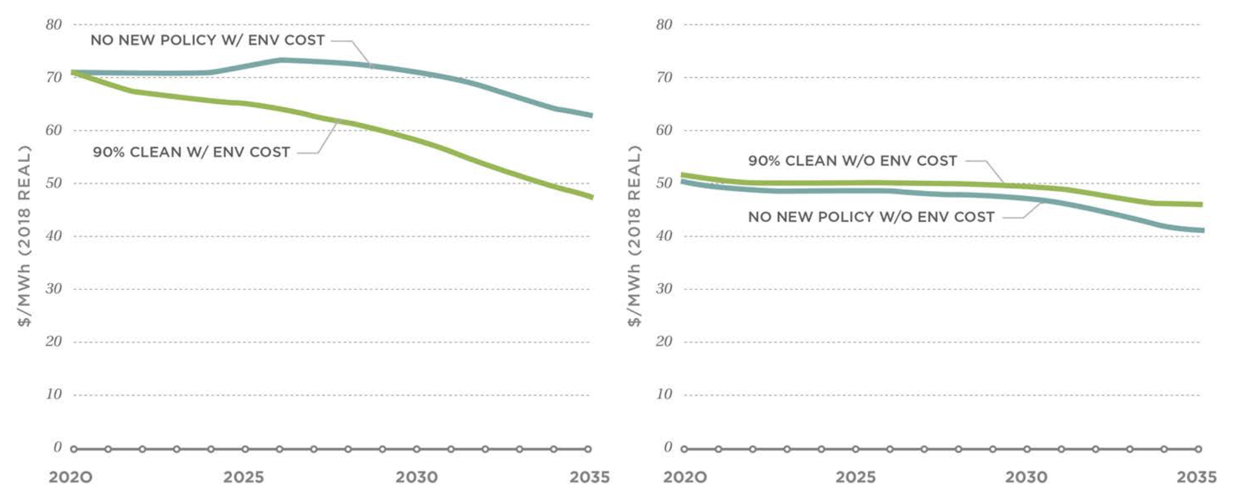
“90% by 2035” is the new “100% by 2050”:
Cost-effectiveness
Annual wholesale electricity costs | 90% carbon-free vs. “business as usual”
Accounting for the public health costs of fossil fuels used to generate power, the costs of 90% carbon-free electricity fall far below the costs of a business-as-usual scenario
Even without accounting for any external costs, 90% carbon-free electricity in 2035 would cost less than consumers pay today
Source: 2035 Report by UC Berkeley and GridLab https://www.2035report.com/

Slide 12
Three key messages
The 2020s will be the decade of clean energy
Clean energy technologies (wind, solar, and batteries) have fallen in price to the point where they beat all other forms of generation.
Combinations of clean energy resources can now cost-effectively provide all energy and reliability services provided by gas plants.
Cost declines create new opportunities for utilities and policymakers
Though “100% by 2050” targets are the de facto standard, questions remain about feasibility, costs, and near-term carbon reductions.
In the near term, today’s clean energy costs mean that achieving 90% carbon-free energy by 2035 is achievable, reliable, and cost-effective.
Ignoring clean energy trends creates stranded cost risks for consumers
Competitive market trends illustrate near-term business case for clean energy and stranded cost risk of new gas-fired power plants.
Policymakers and regulators of monopoly utilities can avoid stranded cost risk by requiring competitive, all-source procurement practices.

Slide 13
Competitive US markets are already showing the business case for clean energy vs. new gas-fired capacity
Evolution of interconnection queues in competitive electricity markets, 2018-2020
Power plant developers in ERCOT and PJM, the two most competitive electricity markets, make investments based on expected returns, not regulated cost recovery, and in the absence of any climate policy.
Since 2018, the interconnection queue for clean energy has doubled, even as ~36 GW of gas projects have been cancelled.
Clean energy now makes up 10x the expected capacity of new gas in these markets.
Clean energy
Gas
Source: RMI analysis of ERCOT and PJM interconnection queue data, 2018-2020, and EIA data on new capacity additions; https://rmi.org/clean-energy-is-canceling-gas-plants/

Slide 14
Investors recognize the stranded cost risks of new gas-fired power plants that will soon be out-competed by clean energy
Historic and projected costs of clean energy vs. gas plants
Example: typical Northeast US plant
Since 2010, the cost to build a portfolio of clean energy resources that can displace a gas plant has fallen >80%
2020 is a tipping point: combinations of clean energy resources are now less costly than an equivalent gas plant
Before 2030, it will be cheaper to build new clean energy resources than it is to continue to run existing gas plants; falling costs accelerate this timeline.
Source: 2019 RMI analysis (www.rmi.org/cep-reports), updated with NREL ATB 2020 data

Slide 15
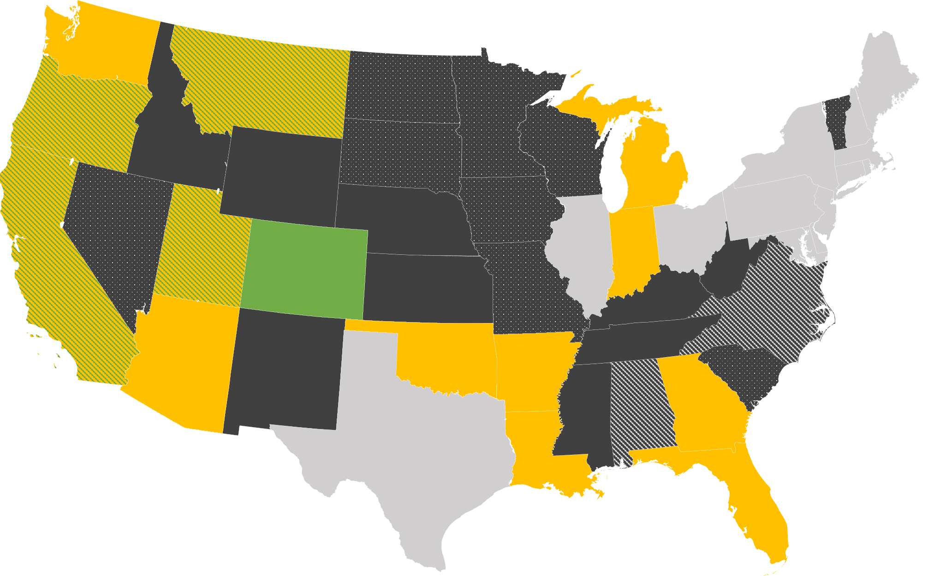







For regulated utilities, “all-source procurement” can mimic competition, maximize consumer benefits, and minimize risks
State policy landscape for competitive resource procurement
Level of competition in new resource procurement:
Restructured market
All-source, competitive solicitation required
Competitive solicitation required; all-source encouraged
Competitive solicitation required
Requirement to demonstrate alternative options prior to procurement
Requirement for limited competitive procurement for renewables
Leading states require monopoly utilities to issue competitive solicitations for new resources, lowering costs for consumers
No formal requirement for competitive solicitation
Source: RMI, How to Build Clean Energy Portfolios; forthcoming

Slide 16
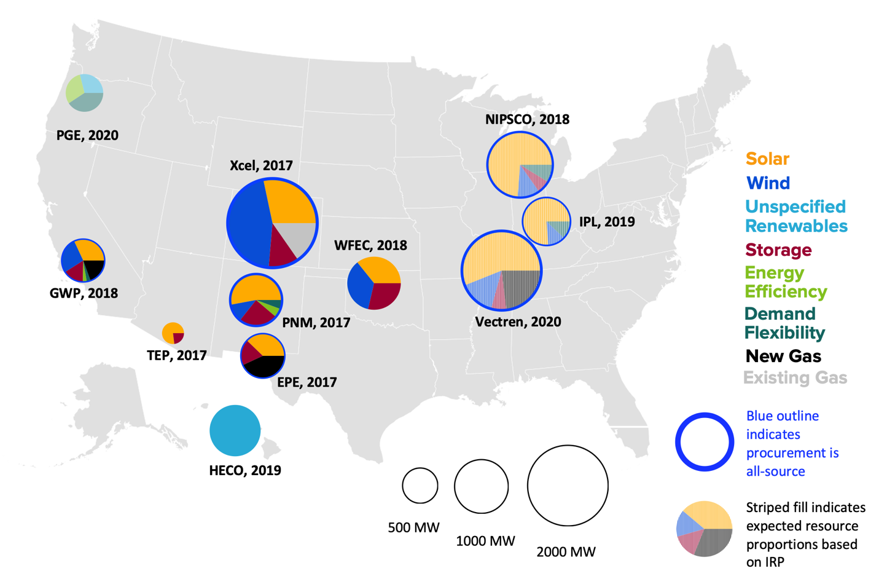
Competitive mechanisms show that clean energy is increasingly displacing or minimizing new gas projects
Summary of recent utility resource procurement outcomes
Utilities across the US that pursue competitive, all-source solicitations for new capacity are increasingly finding that clean energy is cost-competitive with new gas and old coal, and able to support grid reliability as their systems evolve.
Taking advantage of competitive processes can position utilities to move quickly towards decarbonization targets, while minimizing consumer risk and costs.
Source: RMI, How to Build Clean Energy Portfolios; forthcoming

Slide 17
Thank you
Mark Dyson
E: mdyson@rmi.org
T: 303.567.8641
@mehdyson

Slide 18
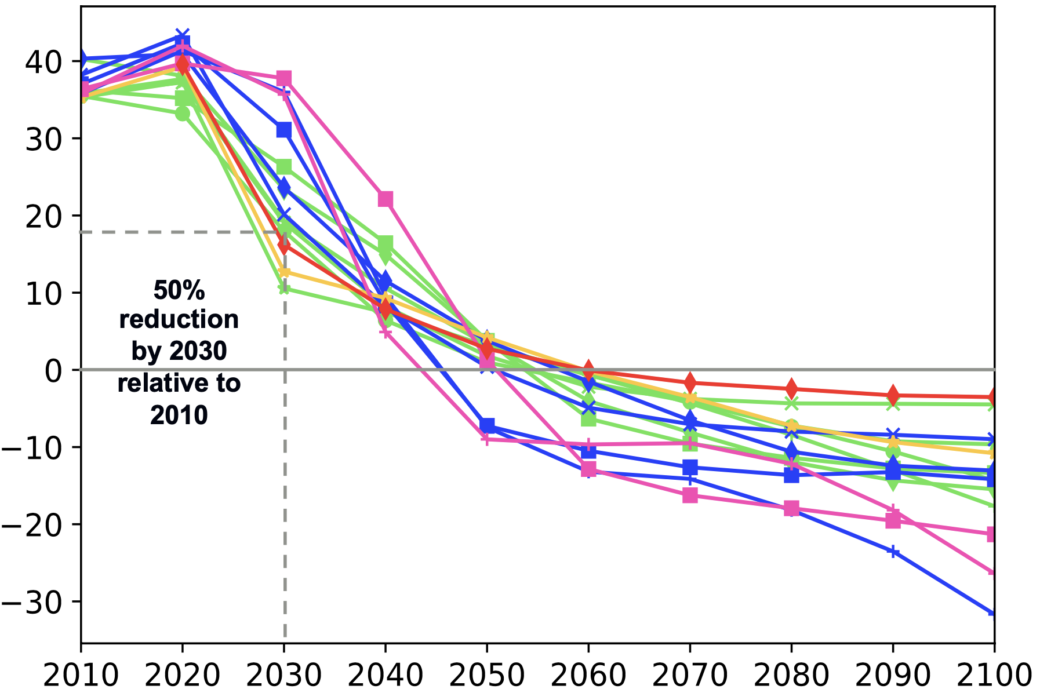
“90% by 2035” is the new “100% by 2050”: Climate alignment
Global net CO₂ emissions for 1.5°C IPCC scenarios
Gt CO₂/year
In 2018, the Intergovernmental Panel on Climate Change (IPCC) released a report that lent momentum to targets for 100% net-zero emissions by 2050 in support of limiting warming to 1.5°C above pre-industrial levels
Less attention has been paid to the more pressing requirement to also reduce economy-wide emissions ~50% by 2030
In all practical scenarios that meet this target, the power system decarbonizes fastest to pave the way for other, harder-to-decarbonize sectors
Sources: IPCC Special Report on Warming of 1.5°C – Summary for Policymakers; LED Database (https://db1.ene.iiasa.ac.at/LEDDB/); and SSP Databases (https://tntcat.iiasa.ac.at/SspDb/)

